Slide 1
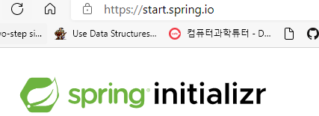
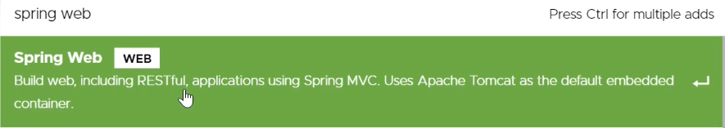
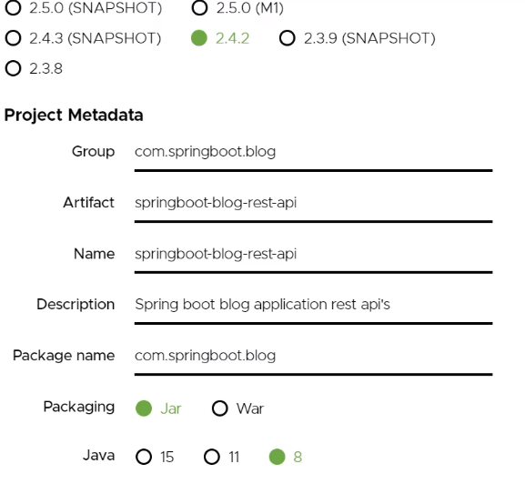
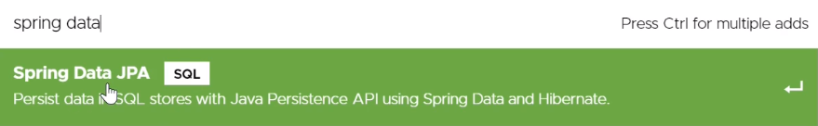
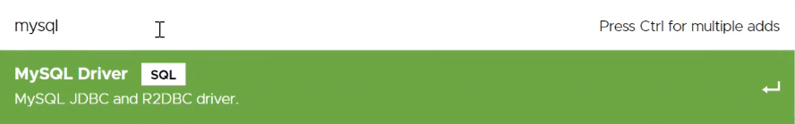
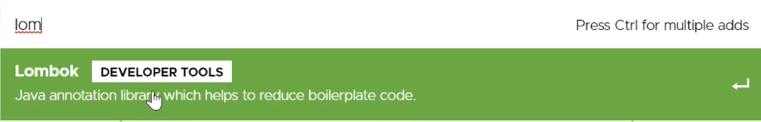
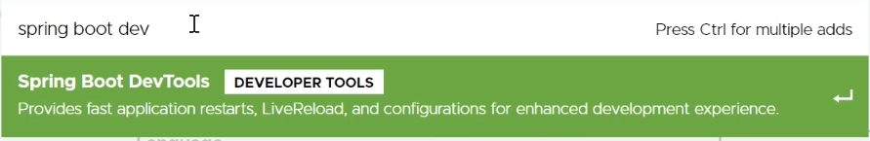
Spring Initializr

Slide 2
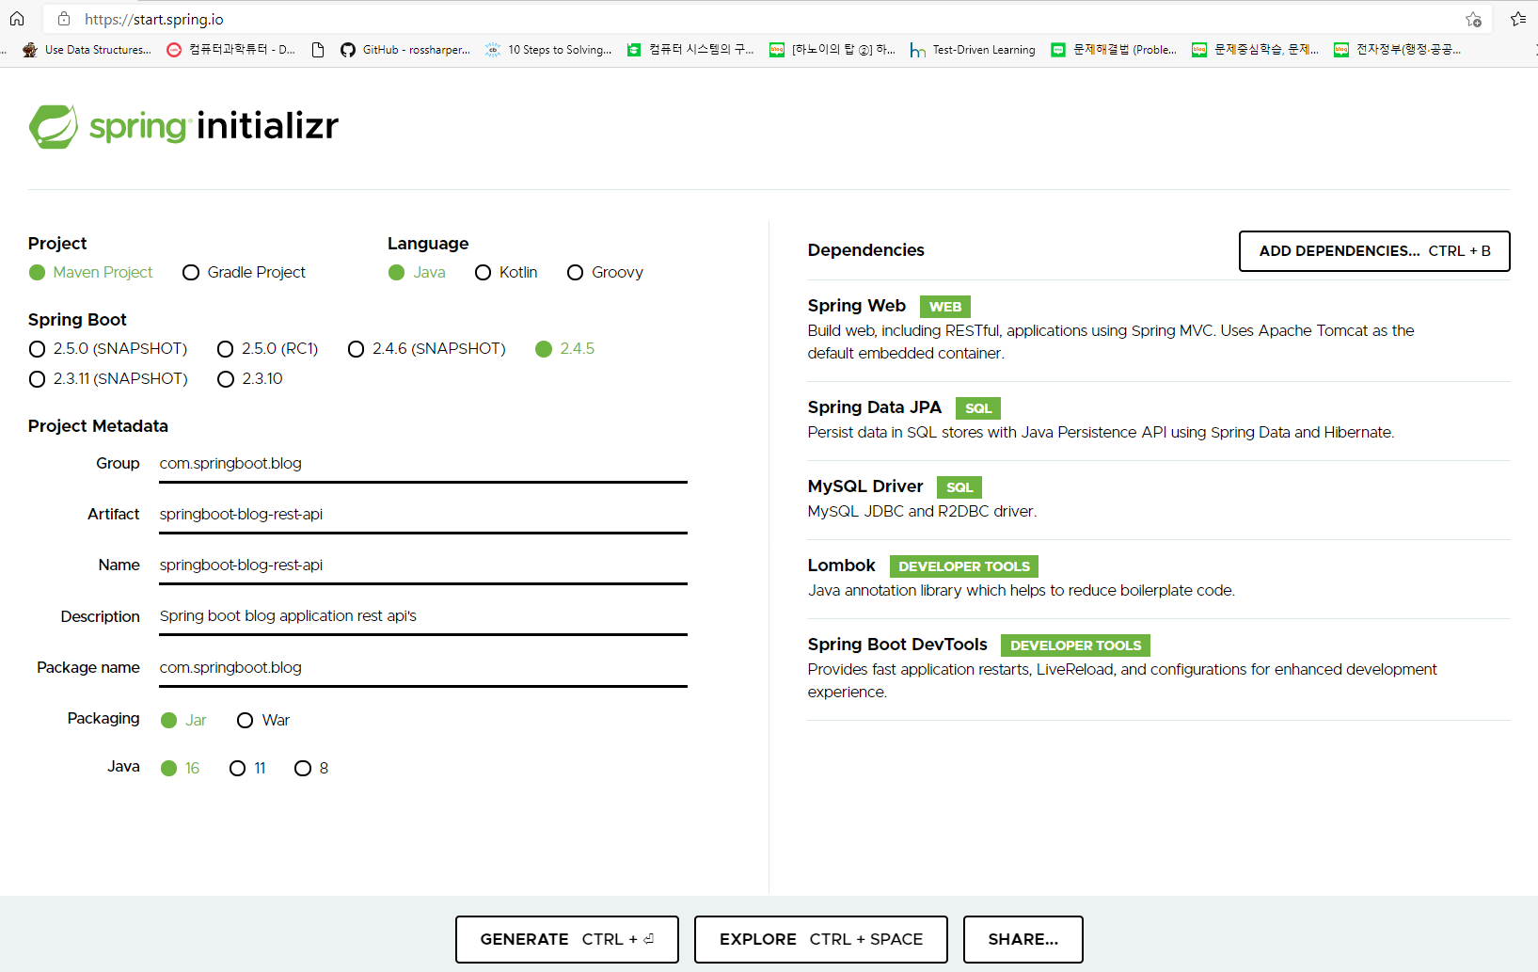

Slide 3
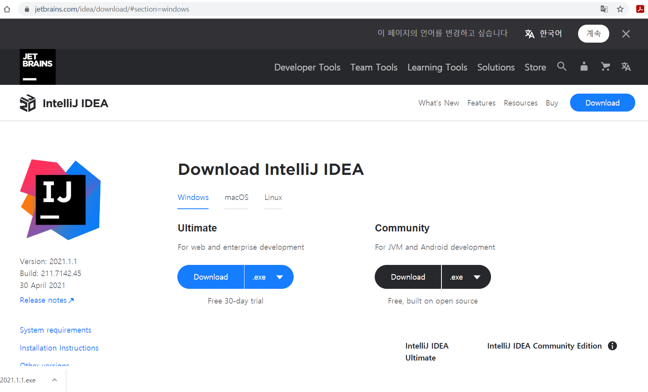

Slide 4
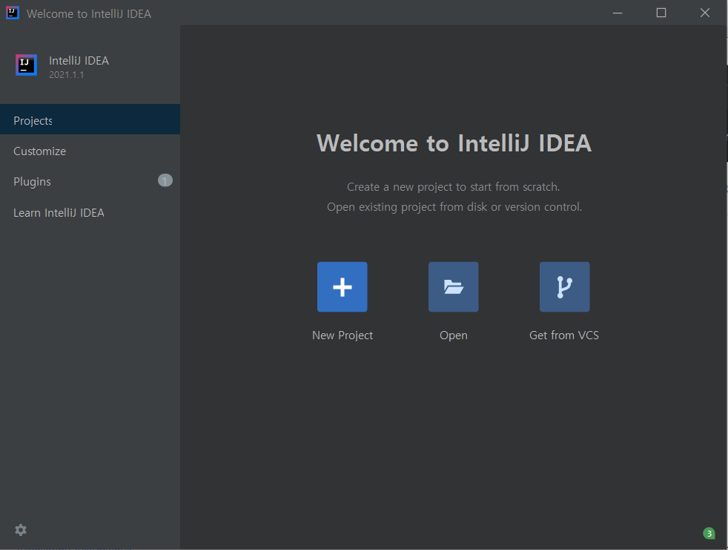

Slide 5
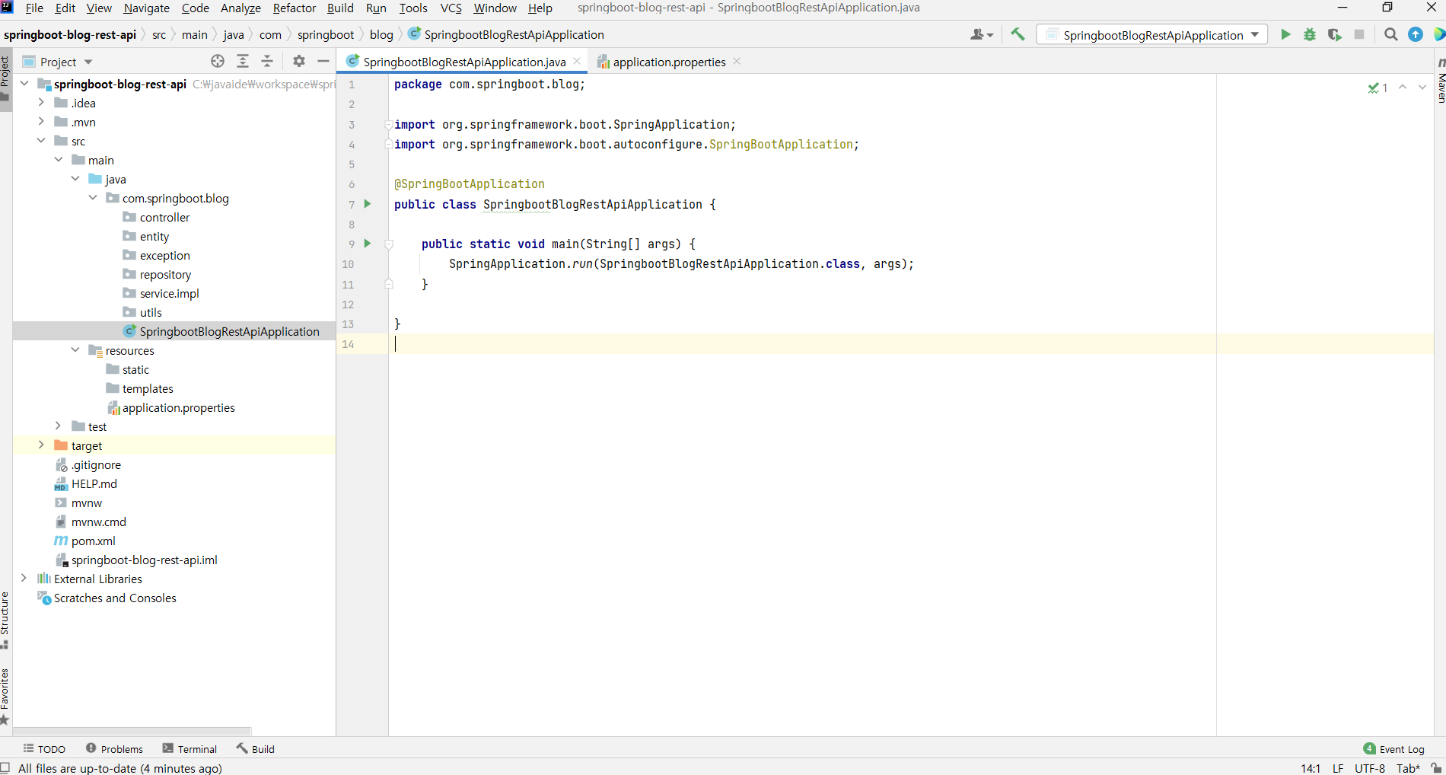

Slide 6
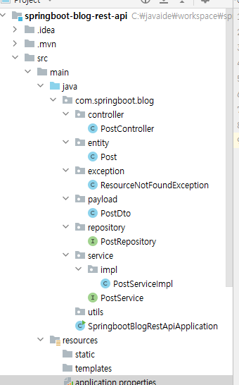

Slide 7
package com.springboot.blog;
import org.springframework.boot.SpringApplication;
import org.springframework.boot.autoconfigure.SpringBootApplication;
@SpringBootApplication
public class SpringbootBlogRestApiApplication {
public static void main(String[] args) {
SpringApplication.run(SpringbootBlogRestApiApplication.class, args);
}
}

Slide 8
package com.springboot.blog.entity;
import lombok.AllArgsConstructor;
import lombok.Data;
import lombok.NoArgsConstructor;
import javax.persistence.*;
@Data
@AllArgsConstructor
@NoArgsConstructor
@Entity
@Table(name = "posts",uniqueConstraints = {@UniqueConstraint(columnNames = {"title"})})
public class Post {
@Id
@GeneratedValue(
strategy = GenerationType.IDENTITY
)
private Long id;
@Column(name = "title", nullable = false)
private String title;
@Column(name = "description", nullable = false)
private String description;
@Column(name = "content", nullable = false)
private String content;
}

Slide 9
package com.springboot.blog.payload;
import lombok.Data;
@Data
public class PostDto {
private long id;
private String title;
private String description;
private String content;
}

Slide 10
package com.springboot.blog.repository;
import com.springboot.blog.entity.Post;
import org.springframework.data.jpa.repository.JpaRepository;
public interface PostRepository extends JpaRepository<Post, Long> {
}

Slide 11
package com.springboot.blog.service;
import com.springboot.blog.payload.PostDto;
import java.util.List;
public interface PostService {
PostDto createPost(PostDto postDto);
List<PostDto> getAllPosts();
PostDto getPostById(long id);
PostDto updatePost(PostDto postDto, long id);
void deletePostById(long id);
}

Slide 12
package com.springboot.blog.service.impl; import com.springboot.blog.entity.Post; import com.springboot.blog.exception.ResourceNotFoundException; import com.springboot.blog.payload.PostDto; import com.springboot.blog.repository.PostRepository; import com.springboot.blog.service.PostService; import org.springframework.beans.factory.annotation.Autowired; import org.springframework.stereotype.Service; import javax.transaction.Transactional; import java.util.List; import java.util.Optional; import java.util.stream.Collectors; @Service //@Transactional is no needed because JPARepository aleady have defaul Transactional annotation public class PostServiceImpl implements PostService { private PostRepository postRepository; // if only 1 constructor @Autowired can be omitted public PostServiceImpl(PostRepository postRepository) { this.postRepository = postRepository; } @Override public PostDto createPost(PostDto postDto) { // convert DTO to entity Post post = mapToEntity(postDto); /* Post post = new Post(); post.setTitle(postDto.getTitle()); post.setDescription(postDto.getDescription()); post.setContent(postDto.getContent()); */ Post newPost = postRepository.save(post); // convert post entity to DTO PostDto postResponse = mapToDTO(newPost); // PostDto postResponse = new PostDto(); // postResponse.setId(newPost.getId()); // postResponse.setTitle(newPost.getTitle()); // postResponse.setDescription(newPost.getDescription()); // postResponse.setContent(newPost.getContent()); return postResponse; } @Override public List<PostDto> getAllPosts() { List<Post> posts = postRepository.findAll(); // java api stream api // we gonna use map // we are just map post entity to DTO // then collect the result // The result is List // service getallposts then postcontroller class moving return posts.stream().map(post -> mapToDTO(post)).collect(Collectors.toList()); }
@Override public PostDto getPostById(long id) { Post post = postRepository.findById(id).orElseThrow(() -> new ResourceNotFoundException("Post","id",id)); return mapToDTO(post); } @Override public PostDto updatePost(PostDto postDto, long id) { // get post by id from the database Post post = postRepository.findById(id).orElseThrow(() -> new ResourceNotFoundException("Post","id",id)); post.setTitle(postDto.getTitle()); post.setDescription(postDto.getDescription()); post.setContent(postDto.getContent()); Post updatedPost = postRepository.save(post); return mapToDTO(updatedPost); } @Override public void deletePostById(long id) { Post post = postRepository.findById(id).orElseThrow(() -> new ResourceNotFoundException("Post","id",id)); postRepository.delete(post); } //convert Entity into DTO private PostDto mapToDTO(Post post) { PostDto postDto = new PostDto(); postDto.setId(post.getId()); postDto.setTitle(post.getTitle()); postDto.setDescription(post.getDescription()); postDto.setContent(post.getContent()); return postDto; } // convert DTO to entity private Post mapToEntity(PostDto postDto) { Post post = new Post(); post.setTitle(postDto.getTitle()); post.setDescription(postDto.getDescription()); post.setContent(postDto.getContent()); return post; } }

Slide 13
package com.springboot.blog.controller; import com.springboot.blog.payload.PostDto; import com.springboot.blog.service.PostService; import org.springframework.http.HttpStatus; import org.springframework.http.ResponseEntity; import org.springframework.web.bind.annotation.*; import java.util.List; @CrossOrigin(origins = "*") @RestController @RequestMapping("/api/posts") public class PostController { // interface is loosing coupling private PostService postService; public PostController(PostService postService) { this.postService = postService; } //create blog post rest api @PostMapping public ResponseEntity<PostDto> createPost(@RequestBody PostDto postDto) { // convert json body to Dto return new ResponseEntity<>(postService.createPost(postDto), HttpStatus.CREATED); } // get all posts rest api @GetMapping public List<PostDto> getAllPosts() { return postService.getAllPosts(); } //get post by id @GetMapping("/{id}") public ResponseEntity<PostDto> getPostById(@PathVariable(name="id") long id){ return ResponseEntity.ok(postService.getPostById(id)); } // update post by id rest api @PutMapping("/{id}") public ResponseEntity<PostDto> updatePost(@RequestBody PostDto postDto, @PathVariable(name="id") long id) { PostDto postResponse = postService.updatePost(postDto, id); return new ResponseEntity<>(postResponse, HttpStatus.OK); } // delete post rest api @DeleteMapping("/{id}") public ResponseEntity<String> deletePost(@PathVariable(name="id") long id){ postService.deletePostById(id); return new ResponseEntity<>("Post entity deleted successfully.", HttpStatus.OK); } }

Slide 14
package com.springboot.blog.exception; import org.springframework.http.HttpStatus; import org.springframework.web.bind.annotation.ResponseStatus; @ResponseStatus( value = HttpStatus.NOT_FOUND) public class ResourceNotFoundException extends RuntimeException{ private String resourceName; private String fieldName; private long fieldValue; public ResourceNotFoundException(String resourceName, String fieldName, long fieldValue) { super(String.format("%s not found with %s : '%s'", resourceName, fieldName, fieldValue)); this.resourceName = resourceName; this.fieldName = fieldName; this.fieldValue = fieldValue; } public String getResourceName() { return resourceName; } public String getFieldName() { return fieldName; } public long getFieldValue() { return fieldValue; } }

Slide 15
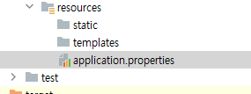
spring.datasource.url = jdbc:mysql://localhost:3306/myblog?useSSL=false&serverTimeZone=UTC spring.datasource.username = root spring.datasource.password = 1111 # hibernate properties spring.jpa.properties.hibernate.dialect = org.hibernate.dialect.MySQL5InnoDBDialect # hibernate ddl auto (create, create-drop, validate, update, none?) spring.jpa.hibernate.ddl-auto = update

Slide 16
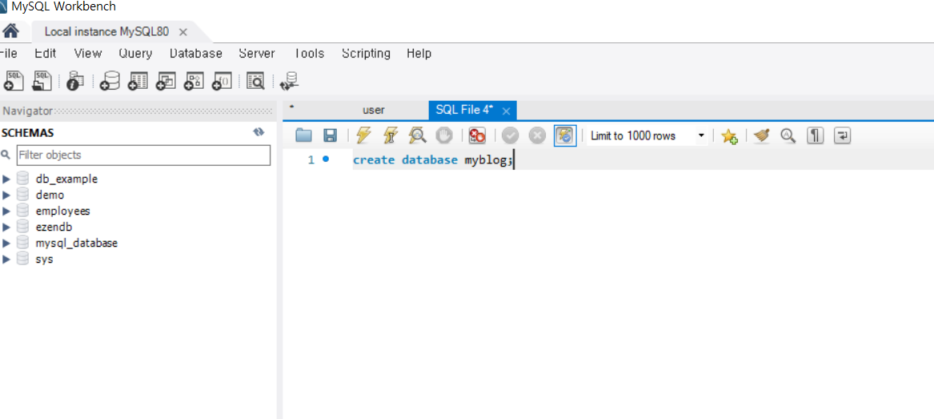

Slide 17
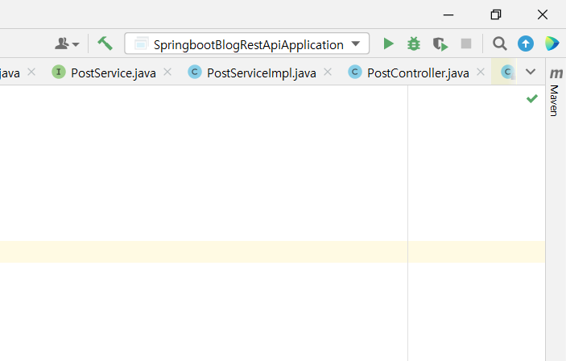

Slide 18
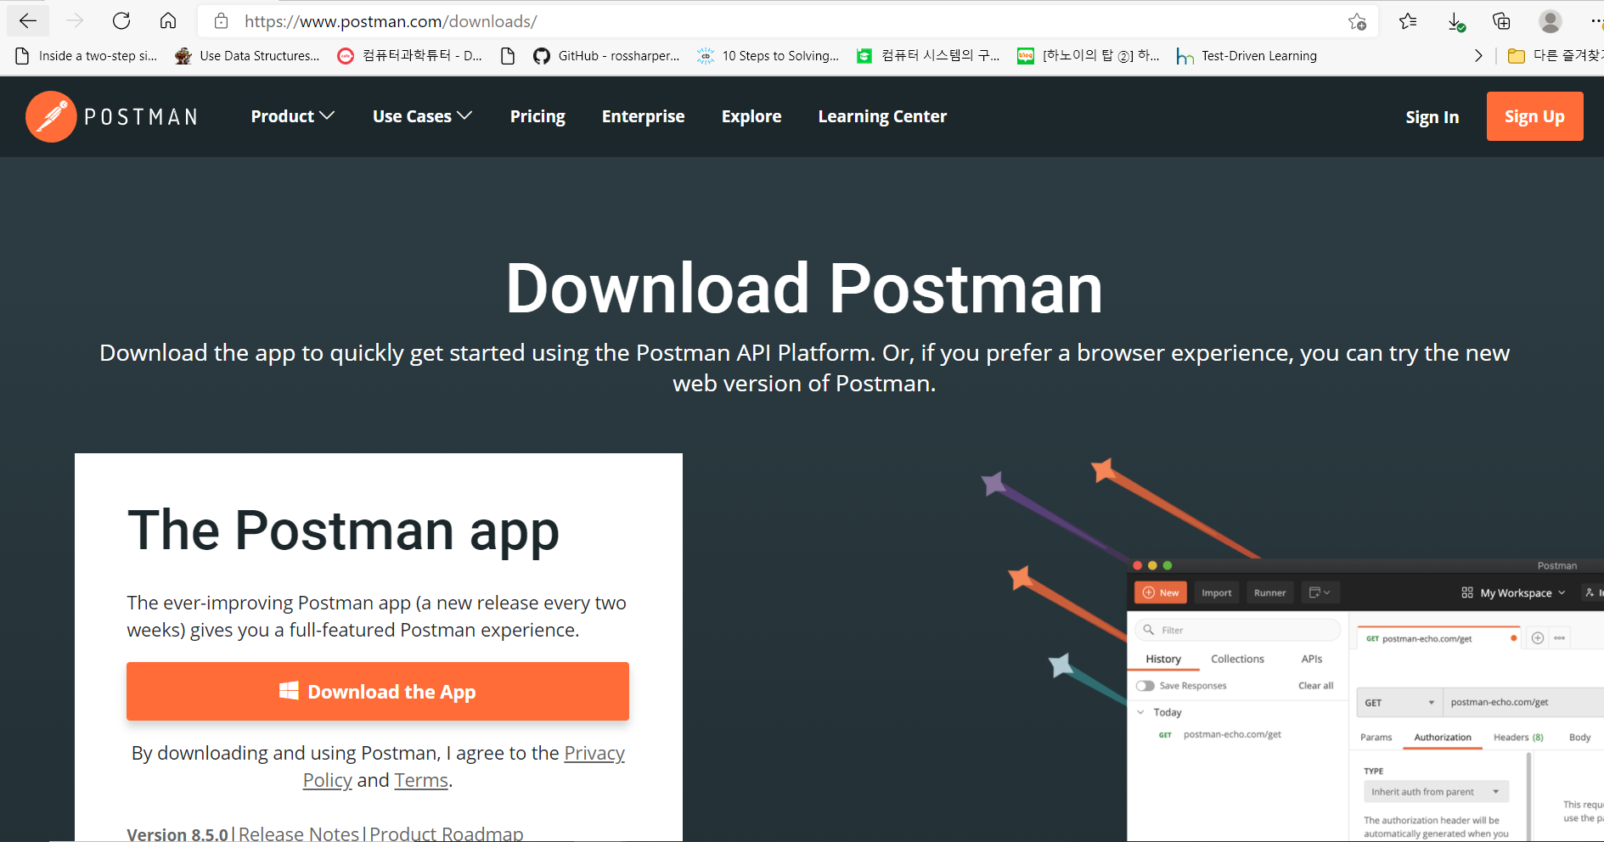

Slide 19
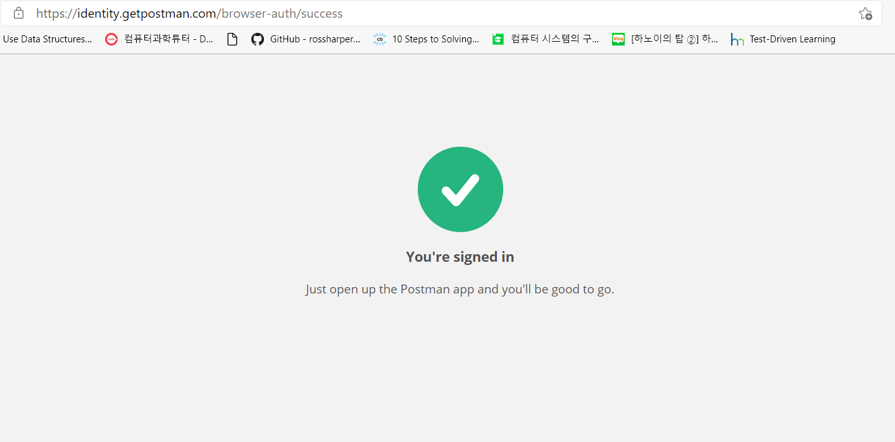

Slide 20
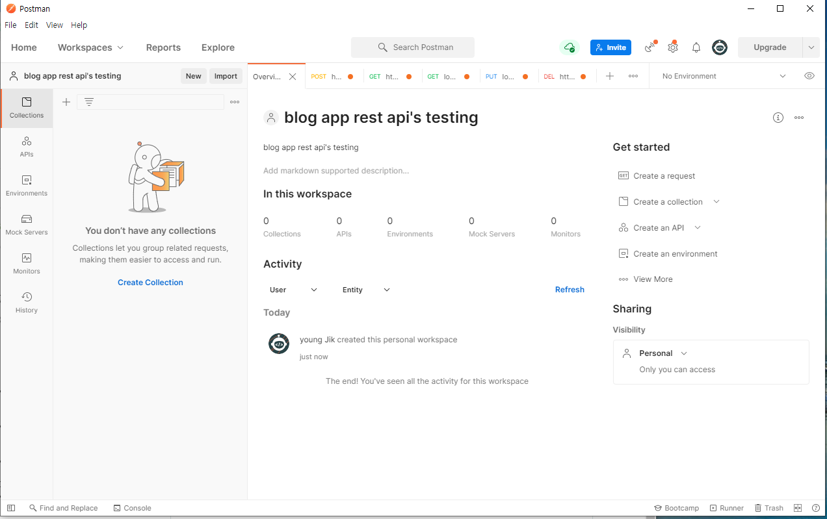

Slide 21
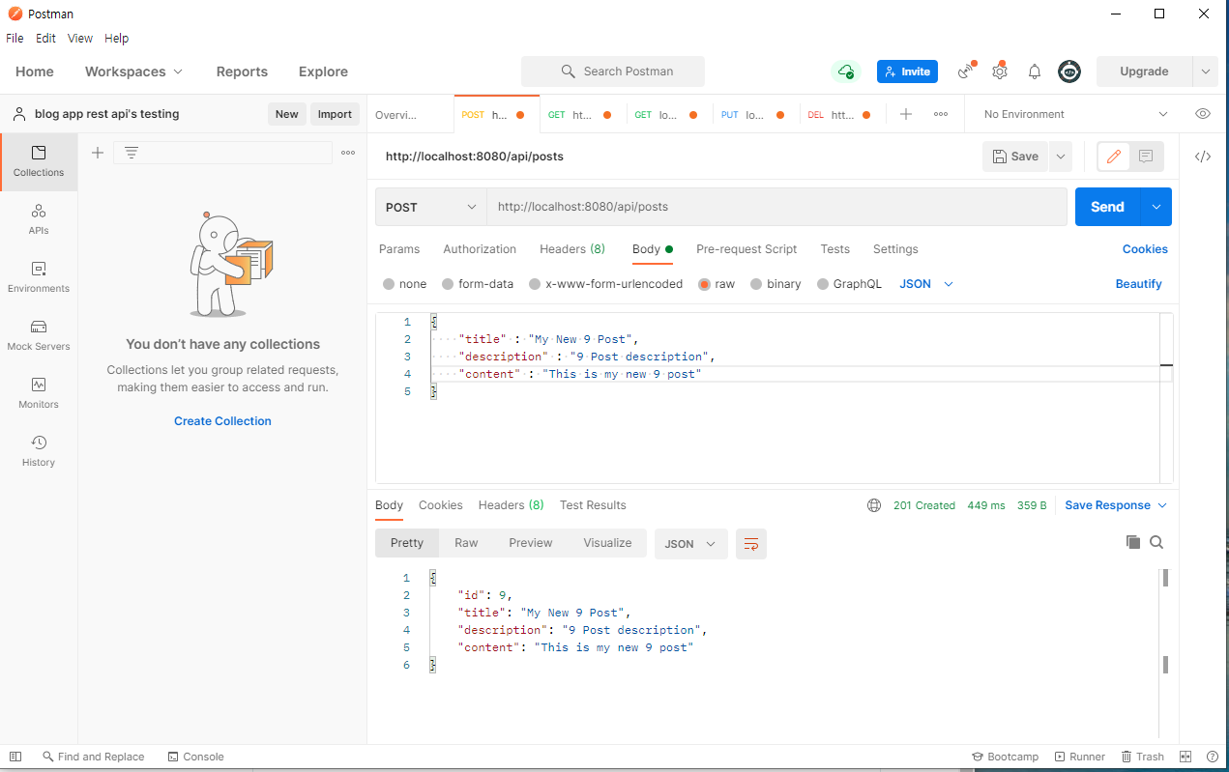

Slide 22
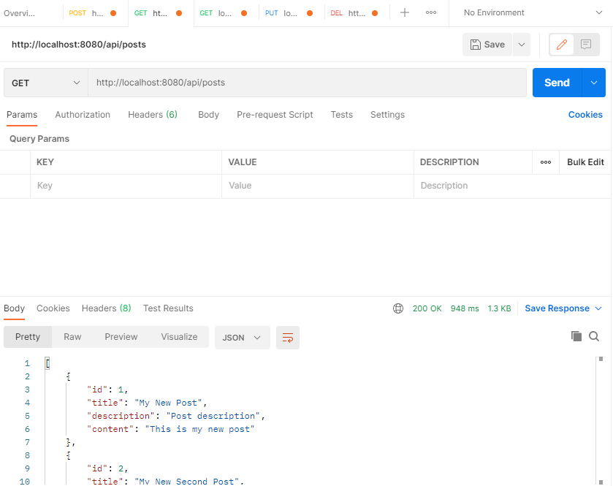

Slide 23
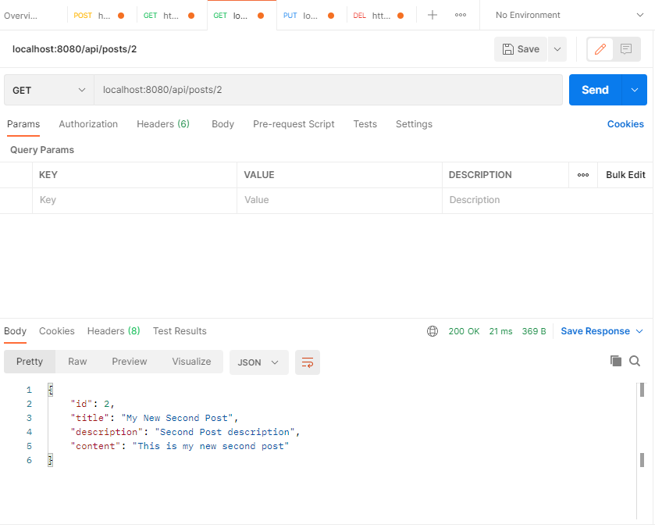

Slide 24
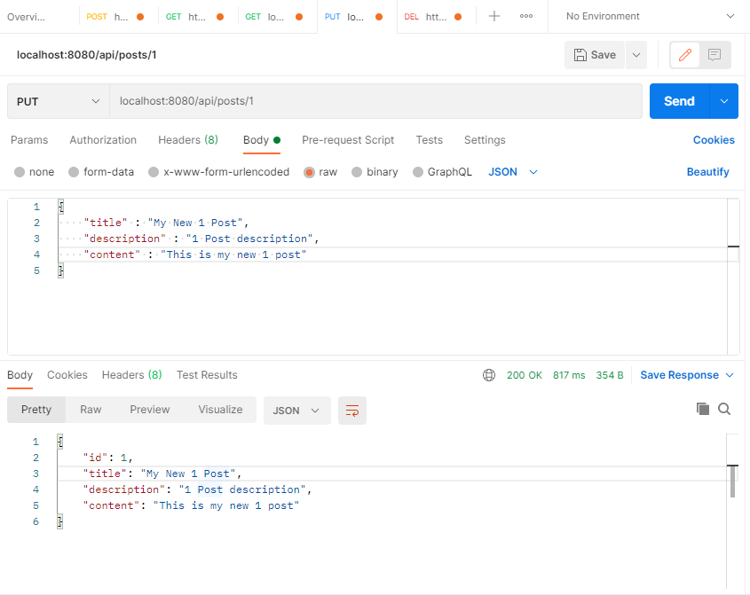

Slide 25
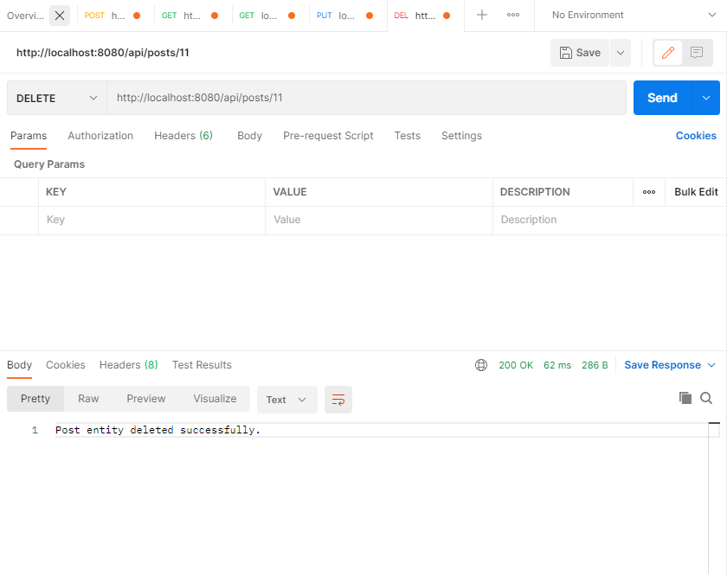

Slide 26
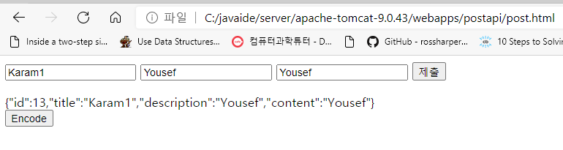
<html>
<head>
<title>test</title>
</head>
<body>
<form id="formElem">
<input type="text" name="title" value="Karam">
<input type="text" name="description" value="Yousef">
<input type="text" name="content" value="Yousef">
<input type="submit">
</form>
<div id="decoded"></div>
<button id="encode">Encode</button>
<div id="encoded"></div>
</body>
<script>
encode.onclick = async (e) => {
let response = await fetch('http://localhost:8080/api/posts', {
method: 'GET',
headers: {
'Content-Type': 'application/json',
},
})
let text = await response.text(); // read response body as text
data = JSON.parse(text);
document.querySelector("#encoded").innerHTML = text;
// document.querySelector("#encoded").innerHTML = `First name = ${data.firstname} <br/>
// Last name = ${data.lastname} <br/>
// Age = ${data.age}`
};
formElem.onsubmit = async (e) => {
e.preventDefault();
var form = document.querySelector("#formElem");
// var form = document.forms[0];
data = {
title : form.querySelector('input[name="title"]').value,
description : form.querySelector('input[name="description"]').value,
content : form.querySelector('input[name="content"]').value
}
let response = await fetch('http://localhost:8080/api/posts', {
method: 'POST', // or 'PUT'
headers: {
'Content-Type': 'application/json',
},
body: JSON.stringify(data),
})
let text = await response.text(); // read response body as text
document.querySelector("#decoded").innerHTML = text;
};
</script>
</html>

Slide 27
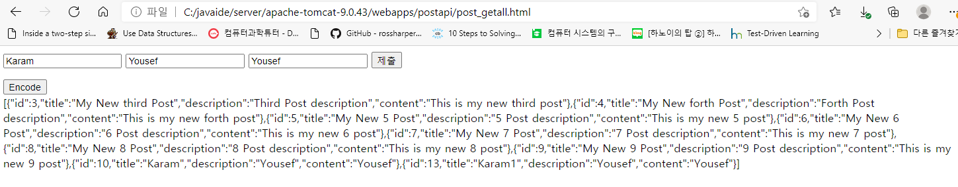
<html>
<head>
<title>test</title>
</head>
<body>
<form id="formElem">
<input type="text" name="title" value="Karam">
<input type="text" name="description" value="Yousef">
<input type="text" name="content" value="Yousef">
<input type="submit">
</form>
<div id="decoded"></div>
<button id="encode">Encode</button>
<div id="encoded"></div>
</body>
<script>
encode.onclick = async (e) => {
let response = await fetch('http://localhost:8080/api/posts', {
method: 'GET',
headers: {
'Content-Type': 'application/json',
},
})
let text = await response.text(); // read response body as text
data = JSON.parse(text);
document.querySelector("#encoded").innerHTML = text;
// document.querySelector("#encoded").innerHTML = `First name = ${data.firstname} <br/>
// Last name = ${data.lastname} <br/>
// Age = ${data.age}`
};
formElem.onsubmit = async (e) => {
e.preventDefault();
var form = document.querySelector("#formElem");
// var form = document.forms[0];
data = {
title : form.querySelector('input[name="title"]').value,
description : form.querySelector('input[name="description"]').value,
content : form.querySelector('input[name="content"]').value
}
let response = await fetch('http://localhost:8080/api/posts', {
method: 'POST', // or 'PUT'
headers: {
'Content-Type': 'application/json',
},
body: JSON.stringify(data),
})
let text = await response.text(); // read response body as text
document.querySelector("#decoded").innerHTML = text;
};
</script>
</html>

Slide 28
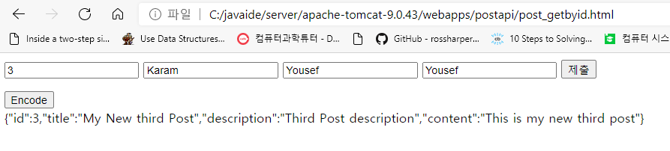
<html>
<head>
<title>test</title>
</head>
<body>
<form id="formElem">
<input type="text" name="id" value="1">
<input type="text" name="title" value="Karam">
<input type="text" name="description" value="Yousef">
<input type="text" name="content" value="Yousef">
<input type="submit">
</form>
<div id="decoded"></div>
<button id="encode">Encode</button>
<div id="encoded"></div>
</body>
<script>
encode.onclick = async (e) => {
let response = await fetch('http://localhost:8080/api/posts/' + document.querySelector('input[name="id"]').value, {
method: 'GET',
headers: {
'Content-Type': 'application/json',
},
})
let text = await response.text(); // read response body as text
data = JSON.parse(text);
document.querySelector("#encoded").innerHTML = text;
// document.querySelector("#encoded").innerHTML = `First name = ${data.firstname} <br/>
// Last name = ${data.lastname} <br/>
// Age = ${data.age}`
};
formElem.onsubmit = async (e) => {
e.preventDefault();
var form = document.querySelector("#formElem");
// var form = document.forms[0];
data = {
title : form.querySelector('input[name="title"]').value,
description : form.querySelector('input[name="description"]').value,
content : form.querySelector('input[name="content"]').value
}
let response = await fetch('http://localhost:8080/api/posts', {
method: 'POST', // or 'PUT'
headers: {
'Content-Type': 'application/json',
},
body: JSON.stringify(data),
})
let text = await response.text(); // read response body as text
document.querySelector("#decoded").innerHTML = text;
};
</script>
</html>

